Slide 1
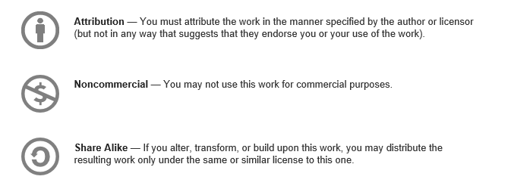
This presentation can be distributed under a Creative Commons License
Notes:
This presentation was originally created for the Kalamazoo X 2013 conference. Many images within this deck are from Creative Commons, Noncommercial, Share Alike licenses.

Slide 2
CHOICE

Slide 3
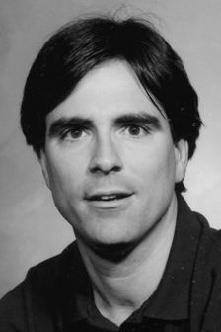
Randy Pausch
October 1960 – July 2008
Image: Public Domain
Notes:
In September of 2007 Randy Pausch, a noted Computer Scientist, gave a lecture called “The Last Lecture: Really Achieving Your Childhood Dreams”. Randy knew he had terminal cancer. If you’ve not seen this you can look it up on You Tube. This has got to be one of the most powerful presentations I’ve ever listened to. He also wrote a companion book that is just as compelling. When I was talking to Mike Eaton about speaking at Kalamazoo X this year he brought up Dr. Pausch’s lecture. He thought something along these lines would be great.
Randy’s talk is filled with great stories and insights, and it lasted well over an hour. I thought very hard about the things I would want to share and wrote tons of notes and ideas down. I had all sorts of ideas around the lessons I’d learned over life, but it just seemed way to much. In looking at all of these ideas and lessons I saw that each of them was learned after a choice I had made. In the end it was the choice I had made, and the repercussion of that choice that mattered.
I decided to talk about choice, and how those choices affect your life.
Image: Image in the public domain - http://en.wikipedia.org/wiki/File:RandyPausch_Wiki_2.jpg

Slide 4

A long time ago, in a city far, far away…
Image: appleswitch
Notes:
Story about drunk driver at hotel
Driver was from out of state, working here on a construction contract. He had a family he hadn't seen in months.
Decision to arrest him or file the damage report and let the lawyers sort it out on reparations.
Arrest would mean taking him to jail, where he would undoubtedly miss work the following day. Lost wages, strained relationship with wife and family already made worse by charges.
Not arresting might lead to him thinking he can drink and drive and then do it again sometime, kill someone.
The choices that any officer makes have consequences. This is NOT an easy job.
Image: appleswitch – Creative common non-commercial, attribution, share alike - http://www.flickr.com/photos/appleswitch/3103651077/

Slide 5
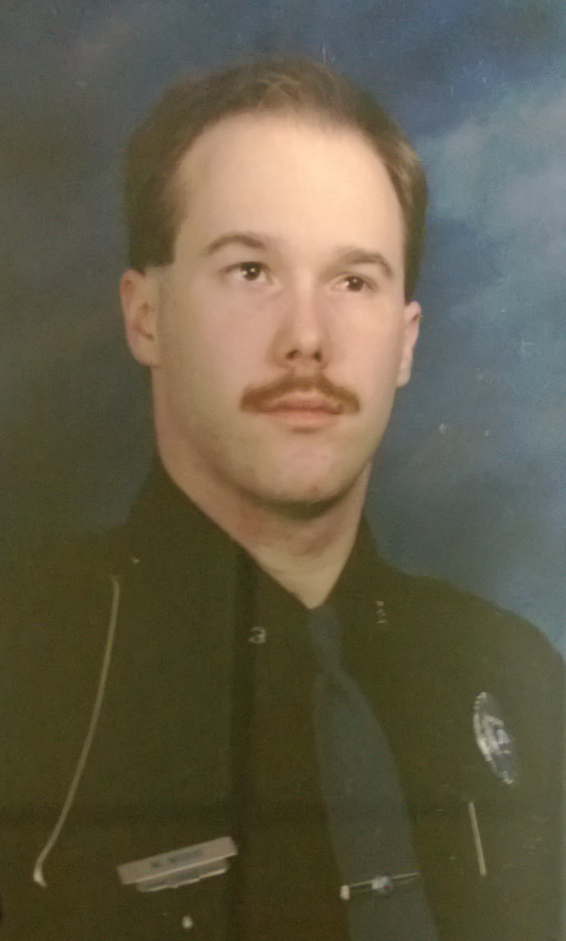
Notes:
I was a little adrift.
I decided that despite wanting to be in law enforcement all my life I didn't want the responsibility of those types of repercussions over other people. I left a position that was part of my plan for life.
Not everything turns out like you expect it to. Get used to that.

Slide 6
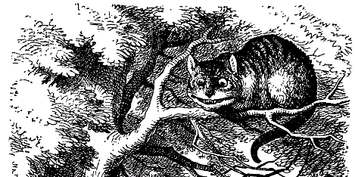
“To live is to choose. But to choose well, you must know who you are and what you stand for, where you want to go and why you want to get there.”
-- Kofi Annan
Image: Public Domain
Notes:
In the story Alice in Wonderland there is a point at which Alice comes to a fork in the road. Above her is a Cheshire Cat in a tree. Alice asks, “Which way should I go?”. The cat asks, “Where do you want to go?”. Alice answers, “I don’t know”, to which the cat replied, “Then, it doesn’t matter.”
Image: This image is in the public domain - http://en.wikipedia.org/wiki/File:De_Alice%27s_Abenteuer_im_Wunderland_Carroll_pic_23_edited_1_of_2.png

Slide 7
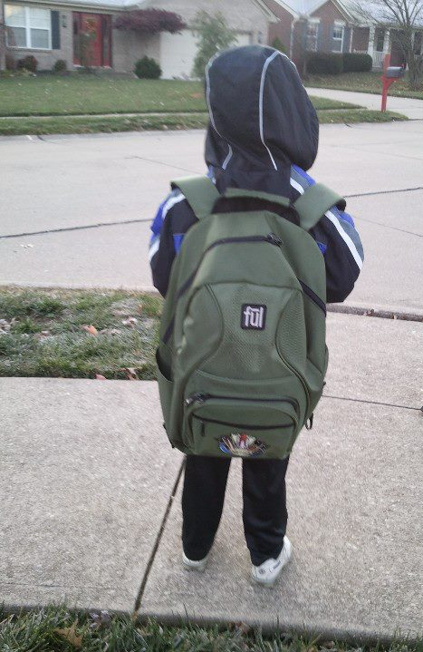
Image: Mike Wood
Notes:
This is a picture of a backpack, with my son attached. When he was in Kindergarten he was, of course, asked, “What do you want to be when you grow up?” They were preparing him for Kindergarten Graduation where they would ask him this question. He had come up with an answer, but on the night of the event when the big microphone was in his face he responded, “a flashlight”.
This question is very commonly asked of as kids get up even into High School, and some into college. But have you asked yourself this question recently? Why is it when we reach a certain age we assume that this question no longer matters? I’d like to think this question matters until the day we die.
We should constantly be asking ourselves this question, and then using that information, as Kofi Annan indicates, to help guide the choices we make in life.
Image: Mike Wood – Creative Commons – Attribution – Share Alike

Slide 8
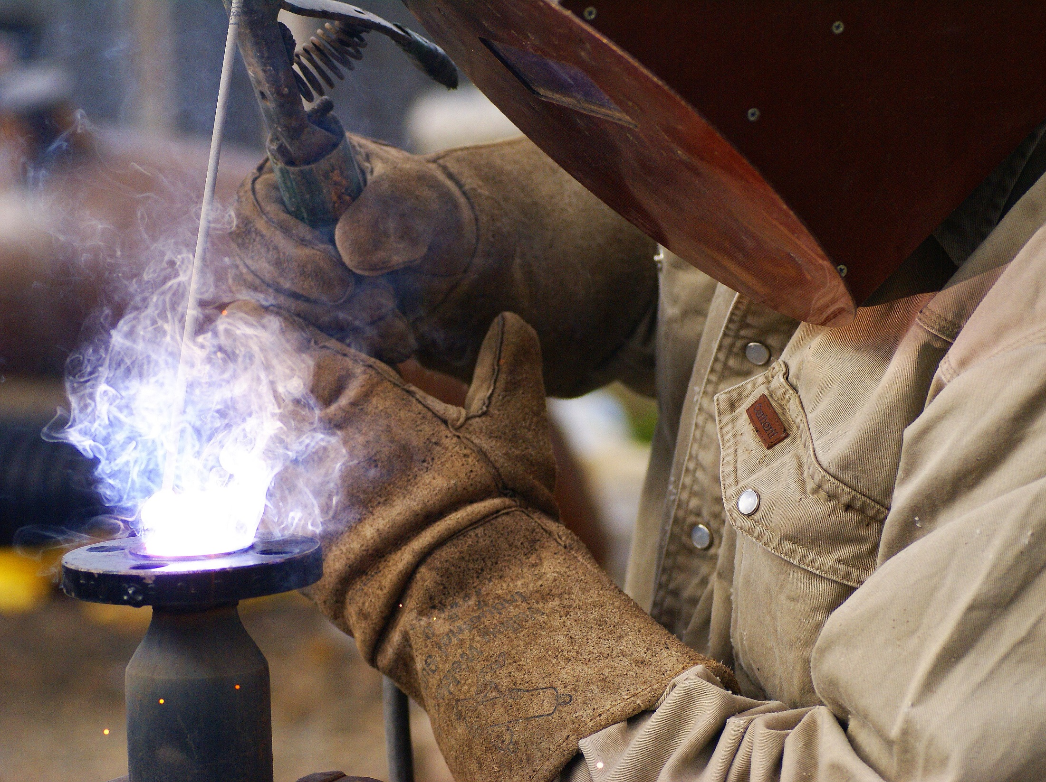
“Opportunity is missed by most people because it is dressed in overalls and looks like work.”
-- Thomas Edison
Image: Lightfoot
Notes:
WHY DON’T WE?
DON”T HAVE A CHOICE?
So why don’t we? Are we just waiting for the right opportunity? Are we waiting to win the lottery or have something that is “just right” land in our laps?
I think that sometimes we think we don’t have a choice. You always have a choice. Sometimes those choices are very, very hard to make. But if you find that you are unhappy with what you do, look at your options, perhaps root out some opportunities, and then make a choice.
Image: By lightfoot, Morgue File – Free to use - http://mrg.bz/ayeaUK

Slide 9
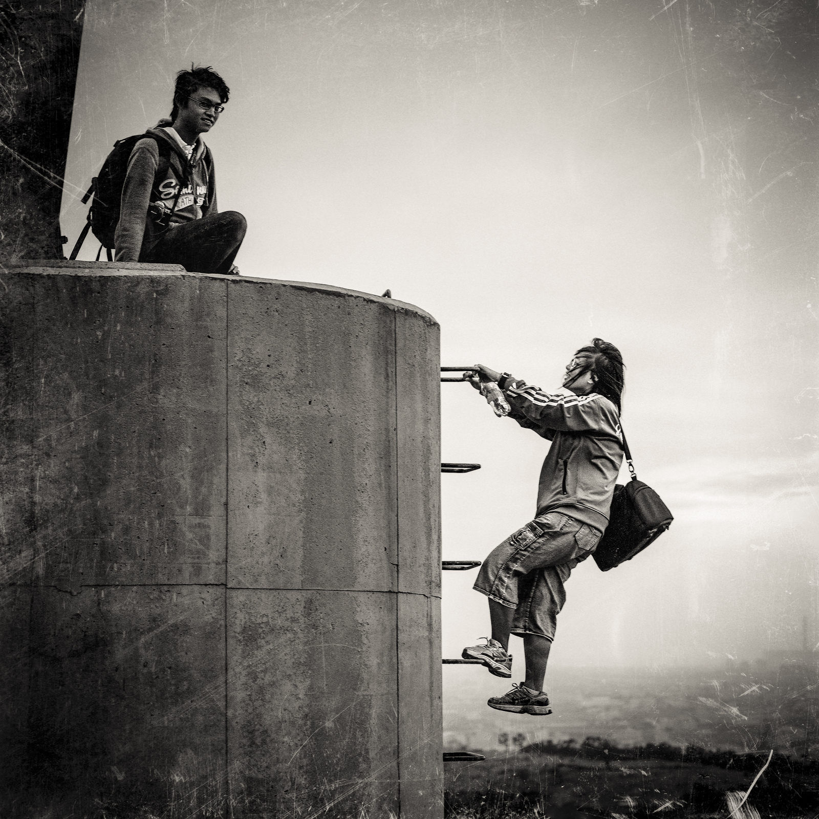
“Don't wait for extraordinary opportunities. Seize common occasions and make them great.”
-- Orson Swett Marden
Image: Shiau Kai
Notes:
Choose to make your own opportunities
KalX is an opportunity
People here can help you where you want to go
I think we sometimes choose to let small opportunities pass us by. Maybe it seems like it’s not that great, or perhaps we are waiting for that awesome opportunity to drop in our laps. Sadly, that doesn’t happen all that often. Many times the opportunities we get are what we make of them.
Choose to make your own opportunities. Don’t wait for something to come by and smack you between the eyes. If you do, you’ll likely still be waiting a year from now.
Image: Shiau Kai - Creative common non-commercial, attribution, share alike - http://www.flickr.com/photos/shiaukai/8023414886/

Slide 10

Image: Cary Grant
Notes:
Sometimes as you try to find or create these opportunities you are going to hit a brick wall. There will be some blocker. Randy Pausch said, “Brick walls are there for a reason. It gives us a chance to show how badly we want something.” I was recently reminded of this when one of my current goals hit a road block. At first, I backed away and started to look at other options, but then, the more I thought about it the more I wanted the opportunity. Now I’ve started coming with ideas on how to get past that brick wall.
I’m thinking about ways I can get where I want to go. In the past I learned that having a little perspective on things has led me to great opportunities.
Image: By Cary Grant – Free to use from MorgeFile - http://mrg.bz/NjTtQR

Slide 11
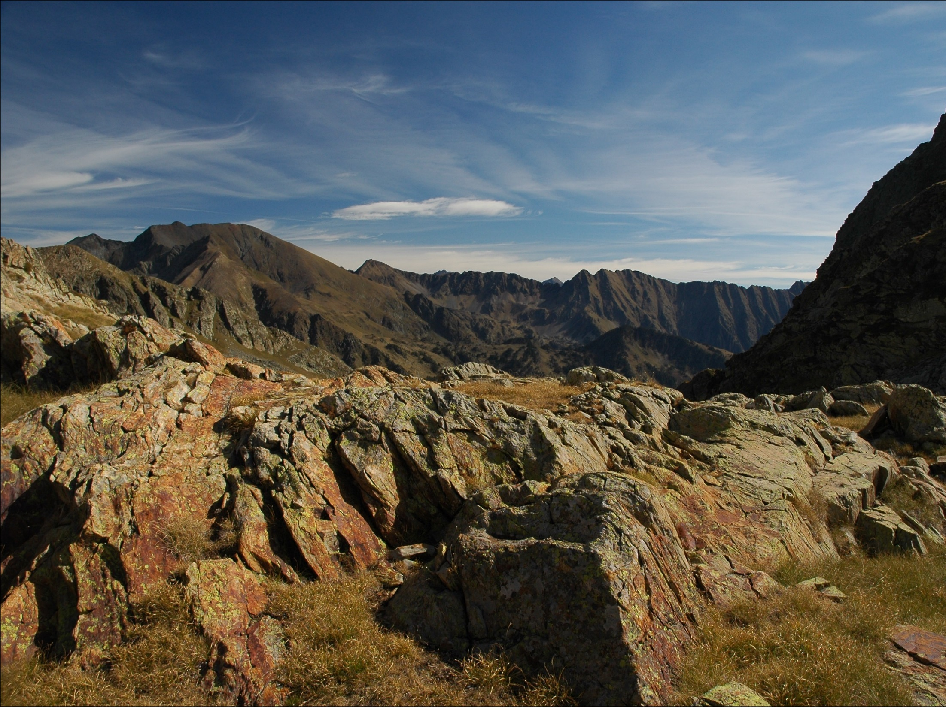
Image: imma
Notes:
WE KNOW OUR VISION, HOW DO WE GET THERE?
GETTING THERE WILL TAKE SOMETHING LARGER THAN YOURSELF.
So, once we know our vision and goal, how do we get there? Well, that will take something larger than yourself.
When I was a Boy Scout I loved going into the wilderness. I especially enjoyed a trip where we spent a week in the Wyoming Grand Teton Mountains riding horseback. Getting into the wilderness, I mean the real wilderness, not the local park, you get a different perspective on things. You look around and see nothing but nature. There are grand vistas where you look out and see not one hint that other men have been there. This gives you the perspective that your life, while filled with issues of it’s own, is but the smallest fraction of the world around.
Image: By Imma – Morgue File – free to use - http://mrg.bz/ho82LJ

Slide 12
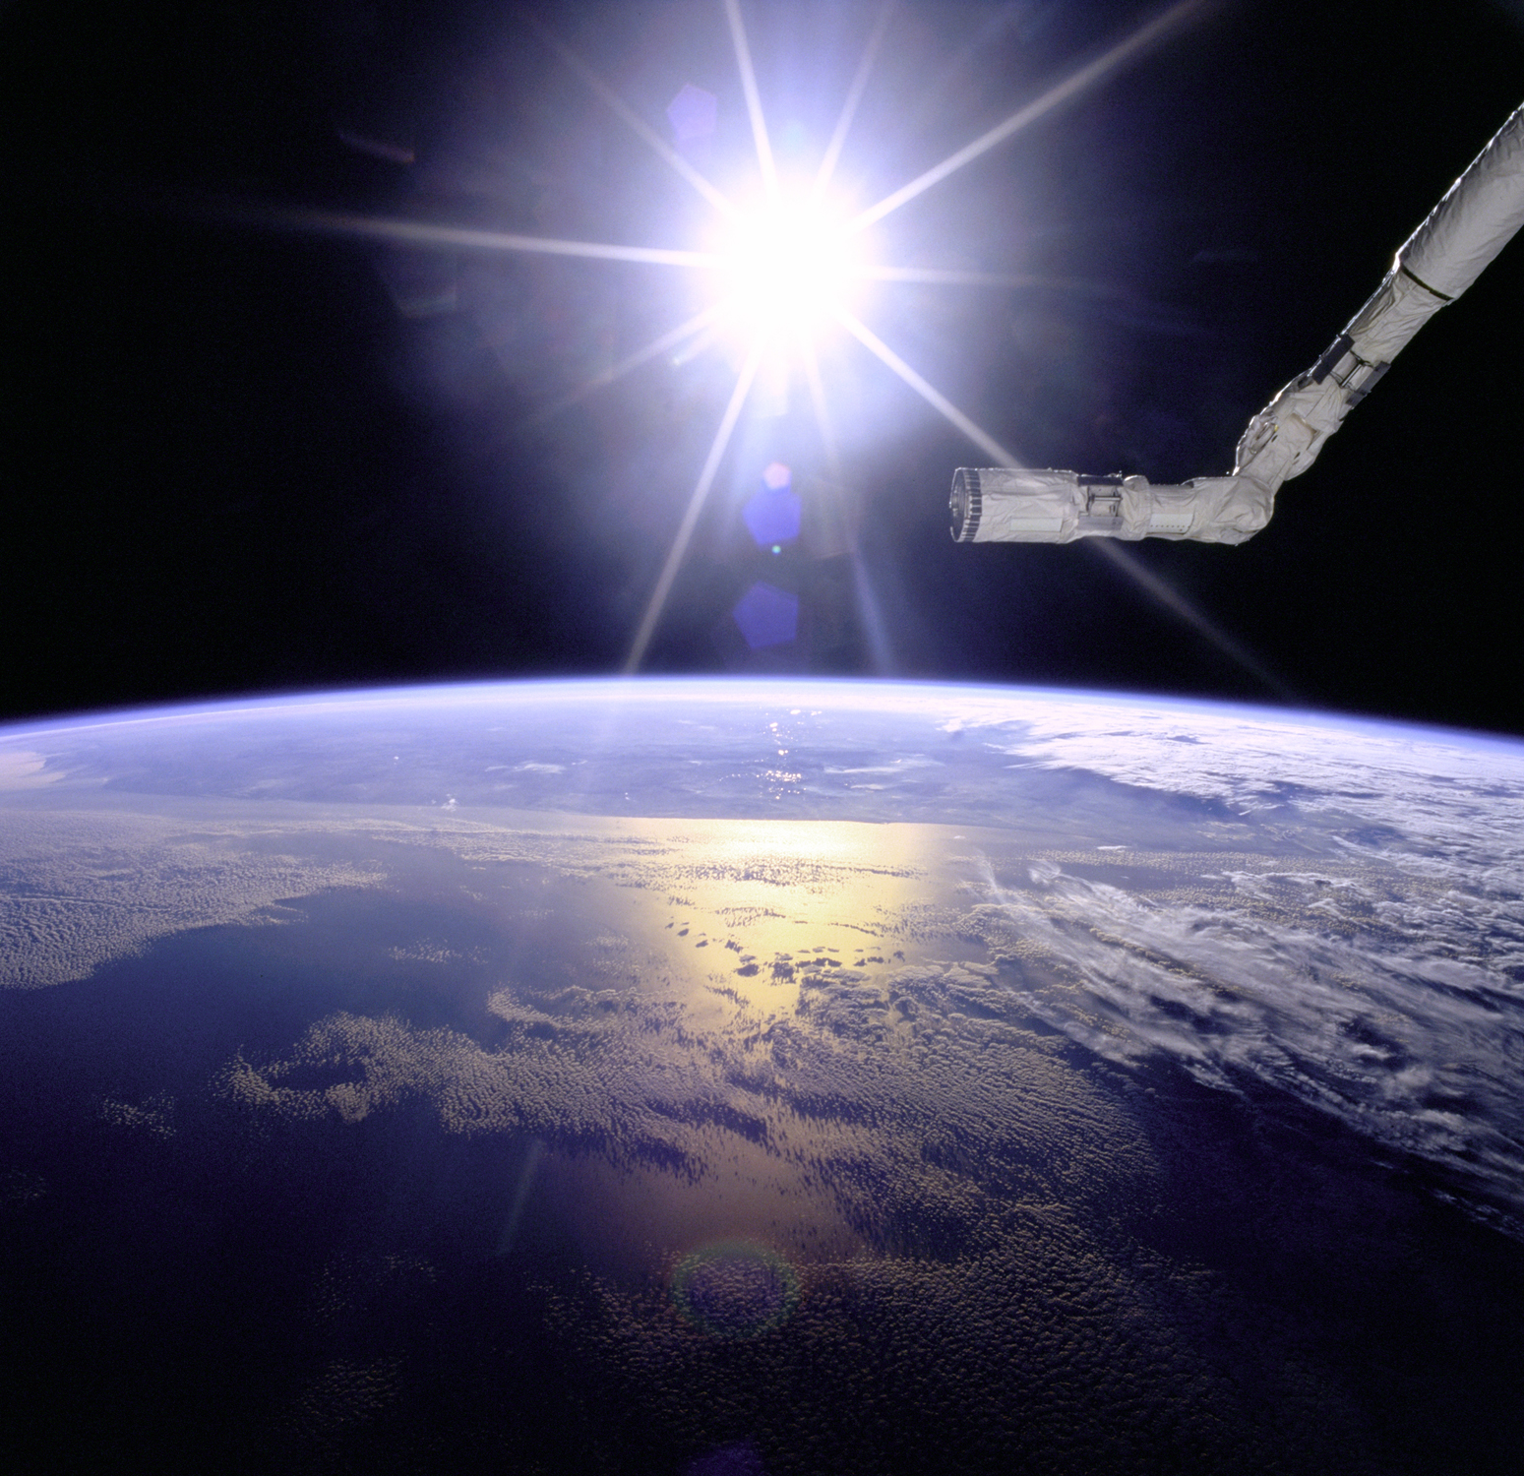
Image: NASA
Notes:
When you take a step even further back and view the perspective from space, the feeling of insignificance grows. It is healthy every now and again to take a step back from your own problems and issues and get a good look at the big picture around you. I’m not saying this to instill some message that your life or situation is not important, far from it. What I’m saying is that understand you are already part of something much larger than yourself and you have a choice in just how much of a part you take.
Image: NASA

Slide 13

Image: Mike Wood
Notes:
Several years ago, back in late 2004 I made a choice to become part of something larger than me. James Avery, Nino Benvenuti and I decided to try to rekindle the Microsoft developer community in Cincinnati. To be honest, it was James driving it and asked if Nino and I would help. At the time I wasn’t sure but made a choice to help where I could. At the first Kalamazoo X I spoke about community, and how ultimately this choice I had made in 2004 and put me on a course to be standing in front of that crowd that day. That statement is no different today. I stand in front of you today because I chose to become part of something larger than myself. By involving myself in the developer community I have gained knowledge, confidence and best of all, relationships that have led me to many great opportunities in my life.
Image: Mike Wood – Creative Commons – Attribution – Share Alike

Slide 14

“Our lives are a sum total of the choices we have made.” -- Wayne Dyer
Image: ramsesoriginal
Notes:
If you have a vision of where you want to be and what you want to be doing, and you take this statement to heart, then does it not make sense that you can find ways to lead to choices that will get you to those goals?
Challenge you to make a choice and learn from today.
"Our lives are a sum total of the choices we have made." -- Wayne Dyer - Self help Guru
That is a very heavy statement.
You may think that simple decisions, such as what to eat, or what TV show to watch won’t be that big of a deal, but for some these decisions have great impact. Talk to a diabetic about the impact of the decisions they make about their diet. What you choose to watch or read can also great provide you creative ideas that you will later use for other, completely unrelated projects. I can’t tell you how many analogies to movies and books I’ve made in presentations and discussions over the years.
I think deep down we know that our decisions have these types of effects, but do we use that information to guide our way?
Think about it. If you know that who you will be tomorrow, next year, or even in a decade depends on the choices you make today, does that change how much emphasis you put on your decisions? Does it change how you approach your decisions? If you have a vision of where you want to be and what you want to be doing, and you take this statement to heart, then does it not make sense that you can find ways to lead to choices that will get you to those goals?
Image: ramsesoriginal – Creative common non-commercial, attribution, share alike - http://www.flickr.com/photos/ramsesoriginal/4710570659/

Slide 15
“Some choices we live not only once but a thousand times over, remembering them for the rest of our lives.”
-- Richard Bach
Image: appleswitch
Notes:
So, what decision did I make that night long ago at the hotel? Did I arrest the man or leave him there? The outcome of that story isn't the point of my talk. The fact that there was a choice, that it was driven by my experiences and my own moral code, is the real take away. It doesn’t matter if it was a good choice or a bad one; rather, I made a choice, I will live with it and it has become a part of who I am.
Image: appleswitch – Creative common non-commercial, attribution, share alike - http://www.flickr.com/photos/appleswitch/3103651077/

Slide 16
Choose who you will be
Thank You

